Slide 1

Dog Bite Data Analysis of New York City Boroughs
Genevieve Burlow, Josh Baltzell, Noelani Williams

Slide 2
Table of Contents
Objective & Description
Our Data
Folium
Ethics & ERD

Slide 3
Objective and Description
What we set out to accomplish:
After finding a data set that we found interesting, we knew that our main objective was to process the data using the ETL framework.
Extraction.
We pulled the data from a government database¹ (data.gov), along with census data pulled from a New York City open database².
Transformation.
We cleaned the data using Pandas after creating a data frame. The designed several functions that were designed to go through the data and remove any data that was unusable (i.e. missing vital data such as breed or location of incident), reformat date-time data, and alter data to be more helpful for our purposes (changing data types, or mathematically altering data into a common unit).
Load.
We exported data to a CSV format, then we analyzed it using postgresSQL. We ran several queries that we used to create some visual elements.
¹https://catalog.data.gov/dataset/dohmh-dog-bite-data/resource/21d7bc57-e2a5-48e2-bf4b-10f13bea946b
²https://data.cityofnewyork.us/City-Government/New-York-City-Population-by-Borough-1950-2040/xywu-7bv9/data_preview

Slide 4

27%
of New York City households own dogs. With this dataset, we wanted to shed some light into the areas where there are higher frequencies of dog bites.

Slide 5

Our Dataset
Post-Extraction

Slide 6
Two Data Sources
Dog Bite Data
NYC Population Data
Found on a government database (Data.gov) with publicly available data.
Found in a New York City government database with publicly available data.

Slide 7
Transformation
Cleaning and Organization.

Slide 8
Main Items for Cleaning
Zip Code
Age
Date-Time
Columns like Zip Code were dropped from data reporting due to several inconsistencies within the data in reporting.
Due to the inconsistency of how age was reported, we needed to run a function that cleaned or removed messy data reporting.
Many of the Incident Dates were reported using non-DateTime formatting, and needed reformatting.

Slide 9
Loading
SQL Queries and Data Analysis.

Slide 10
Our Queries (SQL)
1
2
Incidents by Borough/Year
Incidents to Breed
We compared each borough by year to see if there were any trends in the data.
We queried a count of incidents based on the breed of dogs.
We found that Pitbulls were the number 1 bite reported (1443), followed by pitbull mixes (455), and Shih Tzu (438).

Slide 11
Queries Continued
3
4
Borough Population to Breed
Disaggregation of Borough
We filtered our queries to see what the number one dog breed was for every borough (next slide).
We compared each borough, broken down by breed to see if there were any trends for the number 1 breed in each borough.

Slide 12
Bite Incident by Borough
Queens
Bronx
Manhattan
Brooklyn
Staten Island
Pitbull (411),
Mixed/Mutt (156),
German Shepherd (146)
Pitbull (384),
Shih Tzu (96),
Chihuahua (86)
Unknown (294),
Pitbull (258),
Mixed/Mutt (137)
Pitbull (212),
American Pitbull/Terrier (144),
Mixed/Mutt (139
Pitbull (178),
German Shepherd (46),
Mixed/Mutt (42)

Slide 13
Folium
Imported our data to create a web map of the 5 boroughs and bite totals by year.

Slide 14
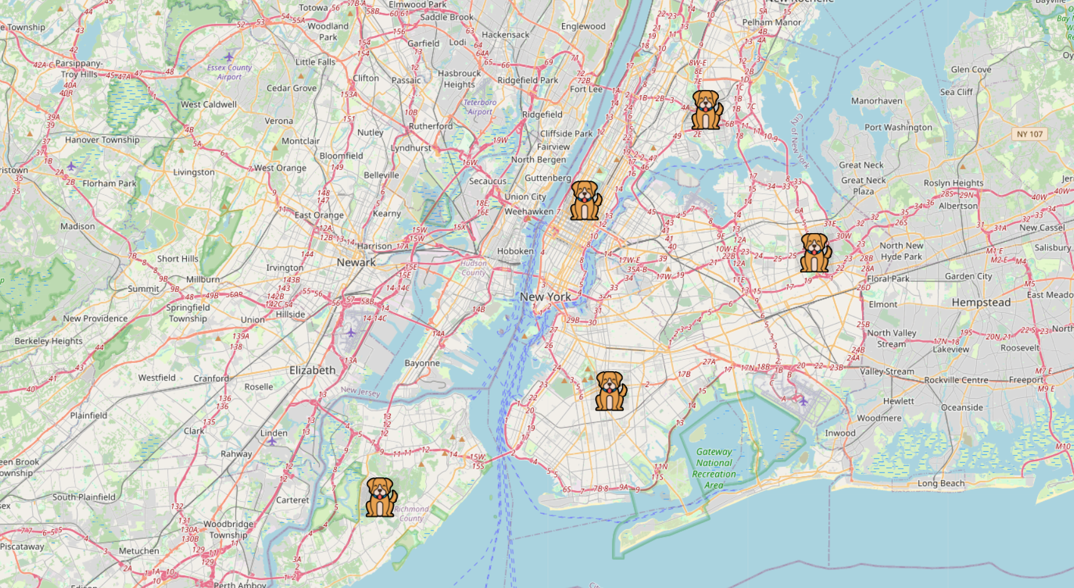
New York City Bite Totals
YEAR | # of INCIDENCE
2015 | 1680
2016 | 1568
2017 | 1717
2018 | 1579
2019 | 1657
2020 | 988
2021 | 1007
2022 | 1328
Folium Map

Slide 15
Ethics and ERD
Structuring our Data and Applying Ethical Considerations.

Slide 16
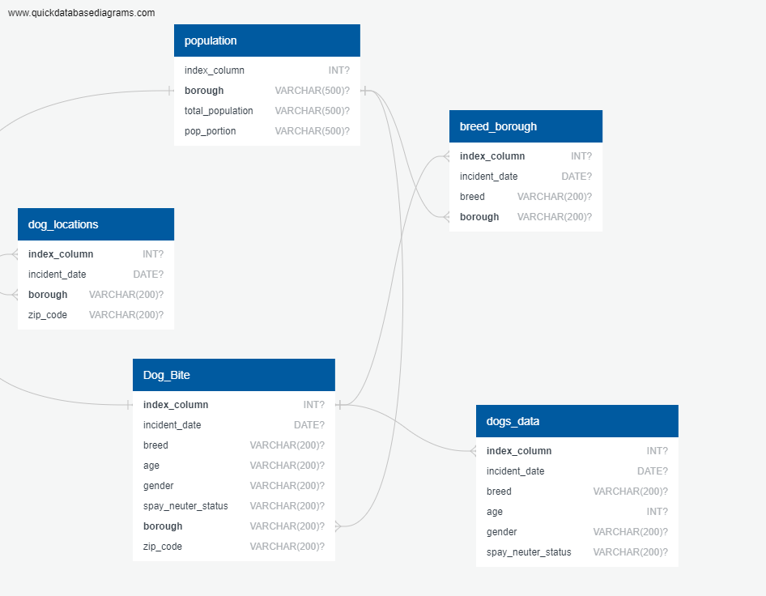
How we structured our datatables.
Here is the structure of our data tables that we used. The original dataset had a Unique ID, but we found that the ID was not actually unique. For this reason, we had to create our own Unique ID index. This was the primary key for multiple tables in our data set.
We also used the name of each borough as a primary key for linking to the population data.

Slide 17

Ethical Considerations
For our project, we needed to consider ethical use of data. We made sure to adhere to five main principles from the United States Department of Commerce Data Ethics Framework. Here are the main principles that we focused on:
Privacy and Confidentiality
Fairness and Inclusiveness
Transparency and Accountability
Safety and Security

Slide 18
Resources
Dog Bite Data (https://catalog.data.gov/dataset/dohmh-dog-bite-data/resource/21d7bc57-e2a5-48e2-bf4b-10f13bea946b) *see dogbites JSON file NYC Population data *see nyc_pop JSON file
Folium starter code (https://python-visualization.github.io/folium/latest/getting_started.html)
Coding Assistance: course instructor, xpert learning assistant, stack overflow

